Slide 1
Singly Linked Lists
Presentation for use with the textbook Data Structures and Algorithms in Java, 6th edition, by M. T. Goodrich, R. Tamassia, and M. H. Goldwasser, Wiley, 2014

Slide 2
Singly Linked List
A singly linked list is a concrete data structure consisting of a sequence of nodes, starting from a head pointer
Each node stores
element
link to the next node
next
element
node
head
∅
A
B
C
D

Slide 3
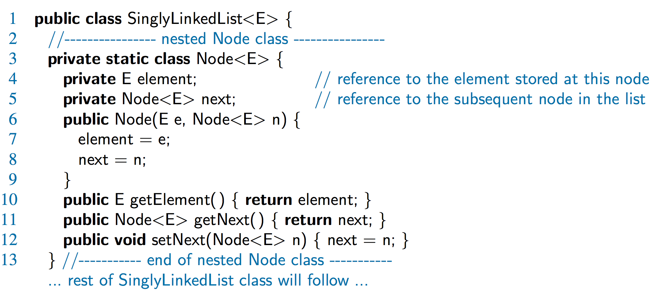
A Nested Node Class

Slide 4
Node object
next
element
node
private static class Node<E> {
/** The element stored at this node */
private E element;
/** A reference to the subsequent node in the list */
private Node<E> next;

Slide 5
SinglyLinkedList object
head
tail
∅
∅
// instance variables of the SinglyLinkedList
/** The head node of the list */
private Node<E> head = null;
/** The last node of the list */
private Node<E> tail = null;
/** Number of nodes in the list */
private int size = 0;

Slide 6
List with 4 elements
head
tail
∅
A
B
C
D

Slide 7
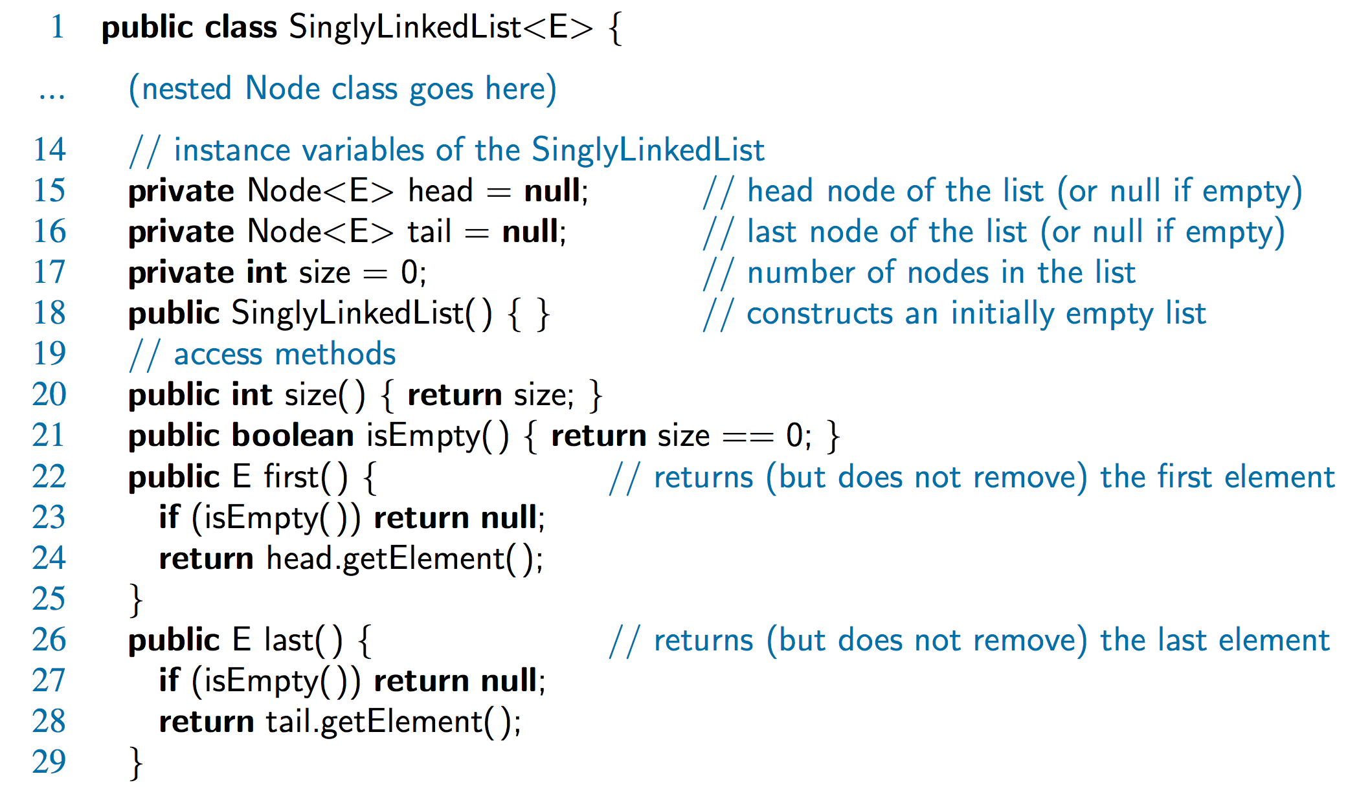
Accessor Methods

Slide 8
Accessor Methods
head
tail
A
D

Slide 9
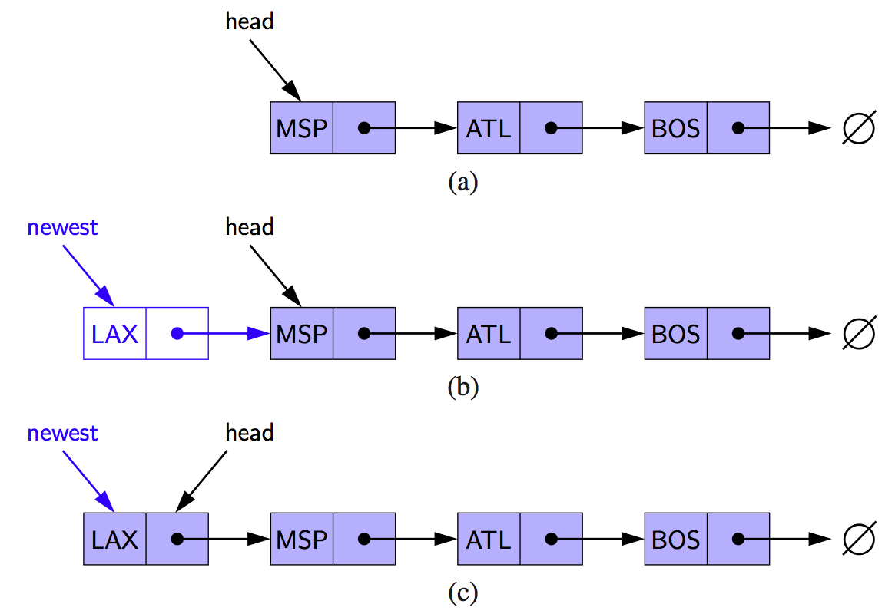
Inserting at the Head
Allocate new node
Insert new element
Have new node point to old head
Update head to point to new node

Slide 10
Inserting at the Head
Allocate new node
Insert new element
Have new node point to old head
Update head to point to new node
newest
head
LAX
MSP
ATL
BOS
∅

Slide 11
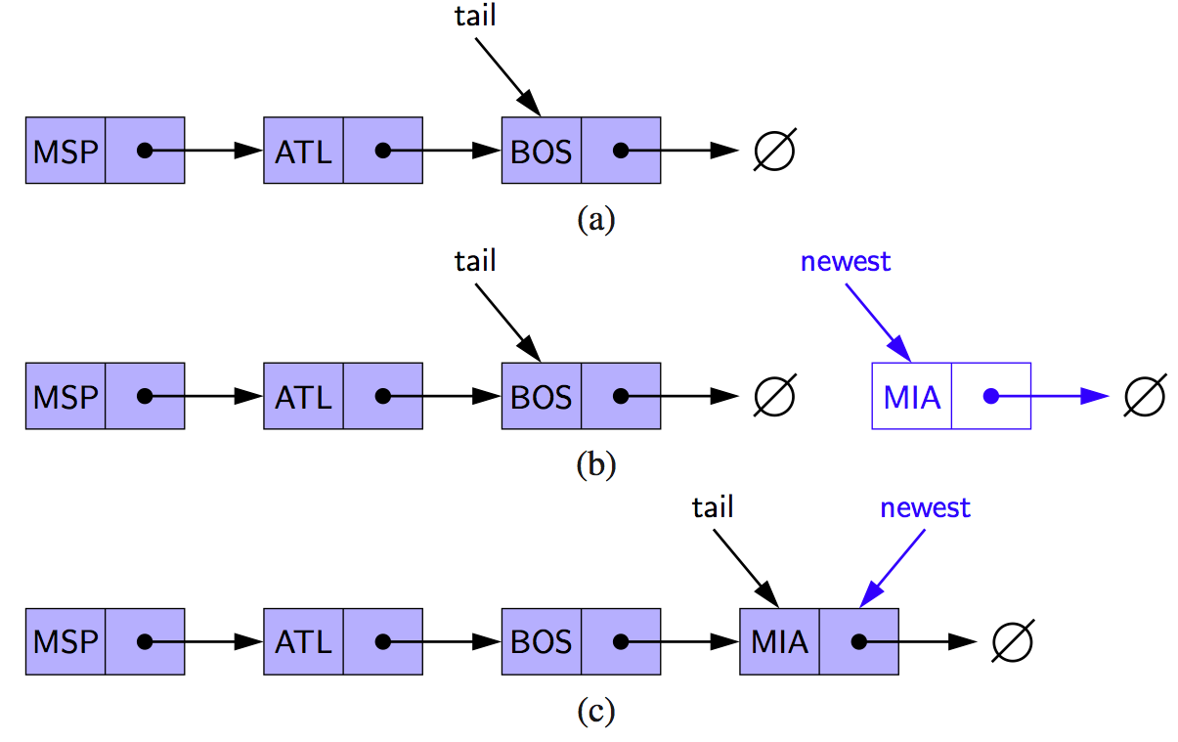
Inserting at the Tail
Allocate a new node
Insert new element
Have new node point to null
Have old last node point to new node
Update tail to point to new node

Slide 12
Inserting at the Tail
Allocate a new node
Insert new element
Have new node point to null
Have old last node point to new node
Update tail to point to new node
newest
head
MSP
ATL
BOS
∅
LAX
∅
tail

Slide 13
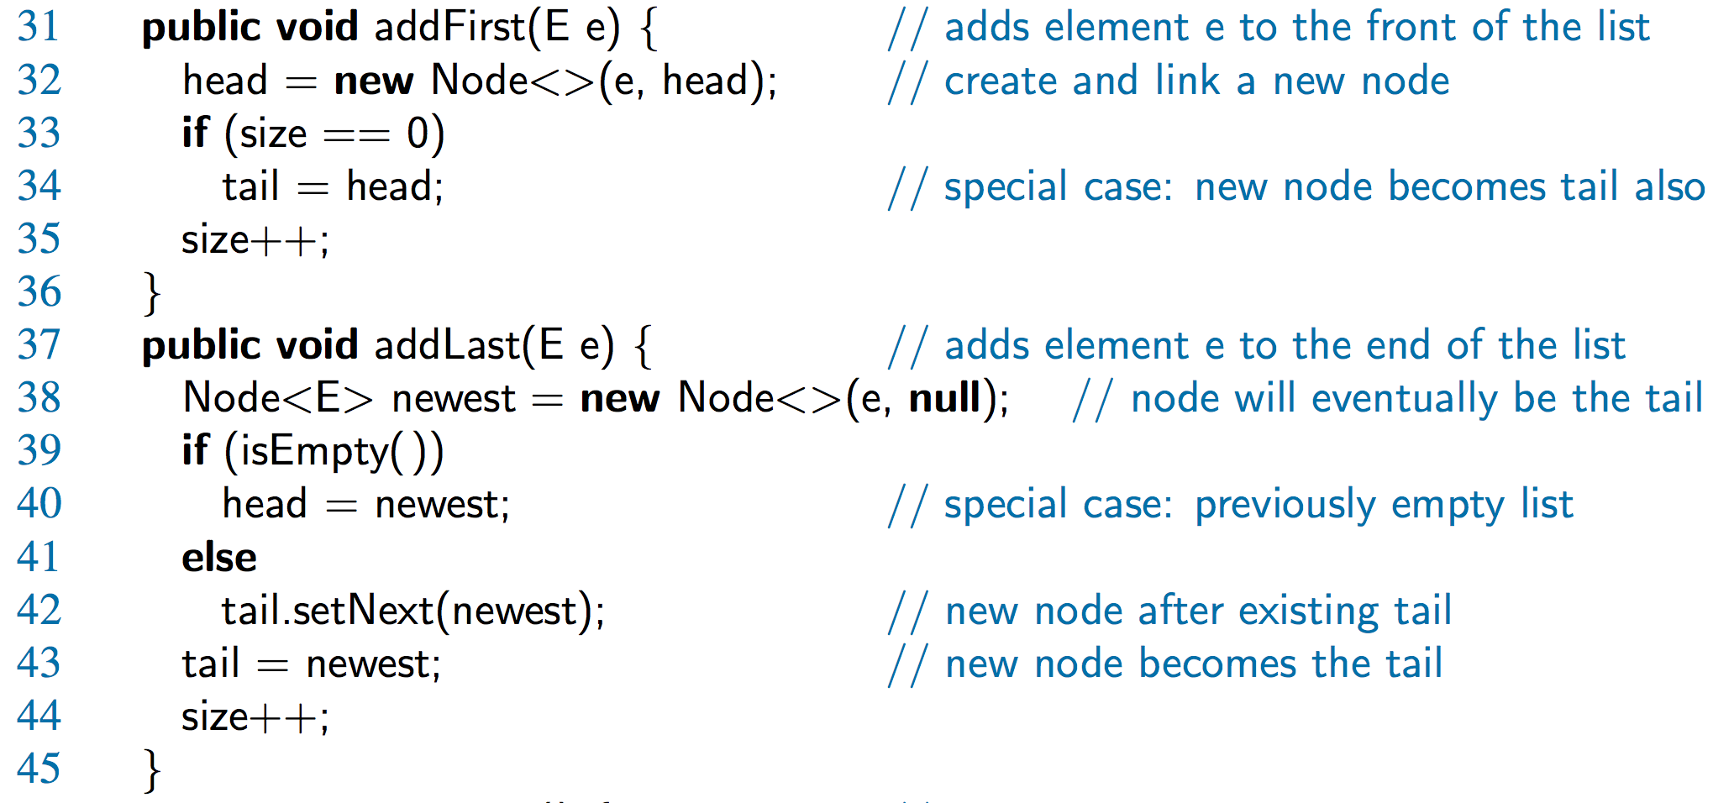
Java Methods

Slide 14
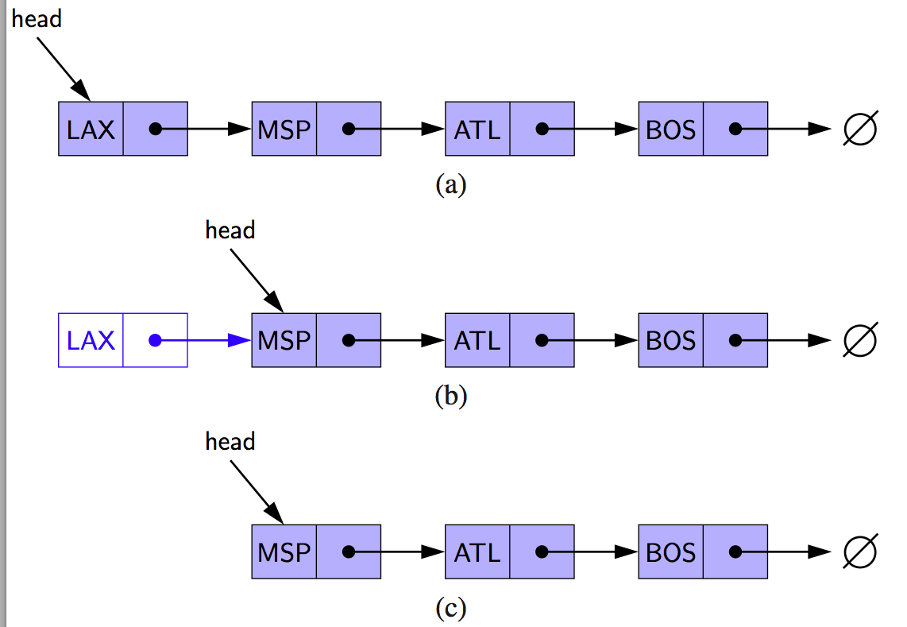
Removing at the Head
Update head to point to next node in the list
Allow garbage collector to reclaim the former first node

Slide 15
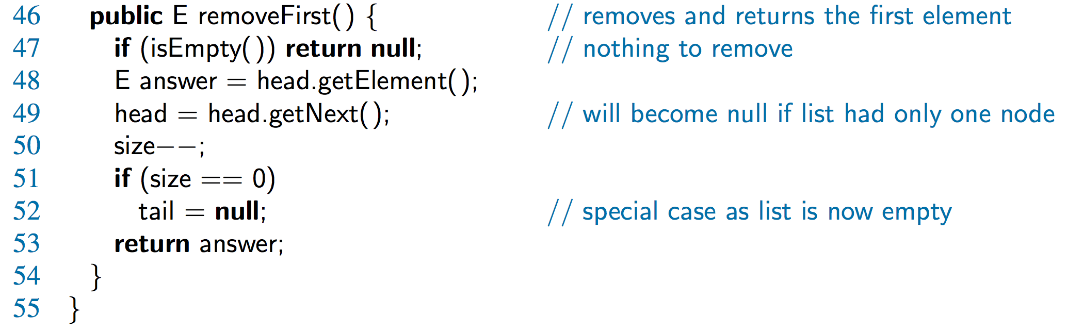
Java Method

Slide 16
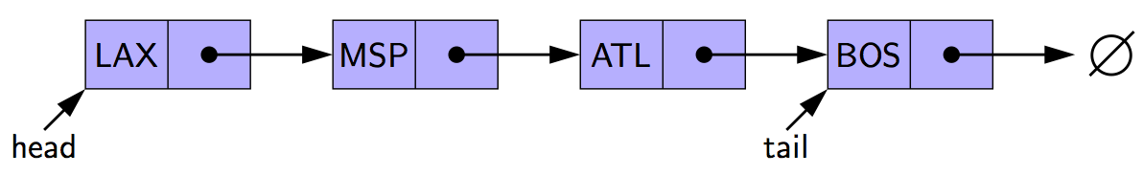
Removing at the Tail
Removing at the tail of a singly linked list is not efficient!
There is no constant-time way to update the tail to point to the previous node

Slide 17
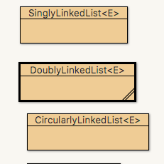
Linked List Example
Open up sourcecode with BlueJ
find package net.datastructures
open
file SinglyLinkedList.java

